Slide 1

IBM Data Science
Capstone project

Slide 2
Final Project
Q1 | Q2 | Q3 | Q4
What is the business problem? | What data will be used? | What methodology will be used? | The results and conclusions from the data.
- Brief description of the business problem. | - Brief explanation of the type of data that would be used. | - Overview of how the project will be conducted. | - A final remark and suggestion for the business problem.
-How the problem will be solved | - How the data will be used to address the business problem. | - Why the methodology is appropriate for the project. | - The data will show the best solution for the problem at hand.

Slide 3
The Business Problem
- Mr. Ronald would like to open a family-oriented, fast-food restaurant in Toronto, Ontario called, “Ronald’s Express.”
- He sells burgers, tacos and pizzas using his own recipes. This is his third restaurant, but he is from a small town called Dundas, Ontario and would like to expand into a bigger city like Toronto.
- He does not know where to begin so he has asked for a data scientist to make a recommendation.
- He says fast-food restaurants require a region “with a lot of people” because this will expose him to many people who could be willing to try his food.

Slide 4
The Data
The data that will be used can be found at.
- The data is the latest census data on Toronto’s neighborhoods.
- It covers the demographics of the region such as population size per neighborhood, percentage of different age groups, minority data, etc.
- The data can be found in an Excel spreadsheet. This makes it easier to clean and use for analysis.

Slide 5
The Results
After analyzing census data, the two most crucial data are the population density and average family income.
Population density is found by dividing the population size by the area size of the neighborhood.
The average family income was provided by census data. It was found that:
- The mean of the average family income across the Toronto region is 80817$
- The median of average family income across the Toronto region is 66727$

Slide 6
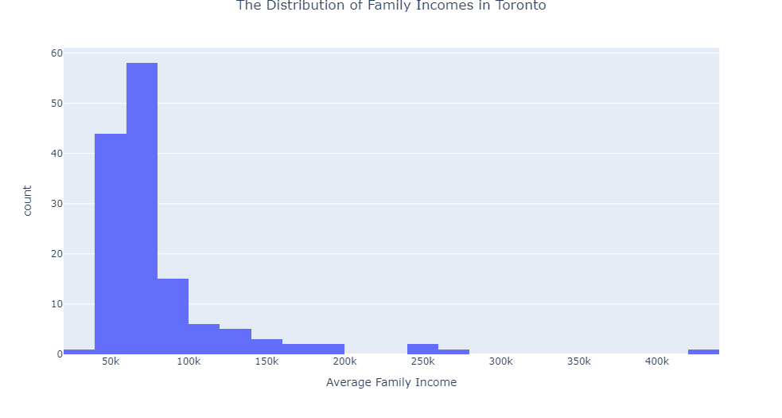
Evidenced on the right, we see that the data is skewed to the right.
From the data, we can observe that there is an outlier present. This will affect statistical analysis.

Slide 7
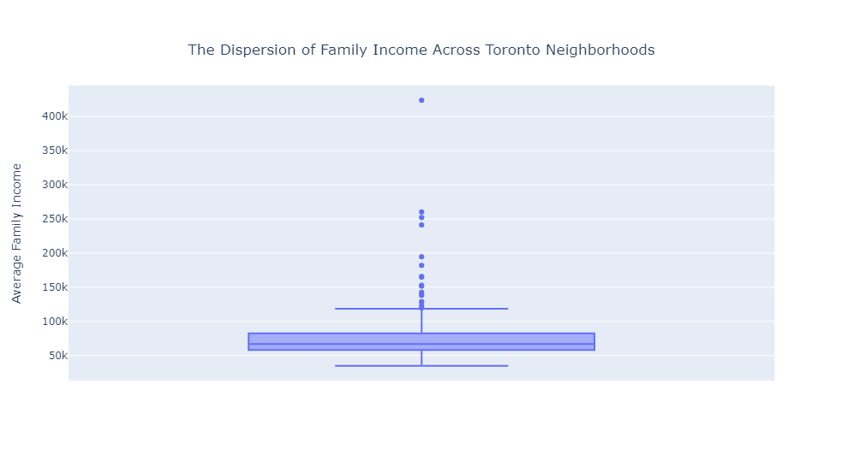
The impact of the findings can be better portrayed using a box plot.
The neighborhood of Bridle Path-Sunnybrook-York Mills is the outlier.

Slide 8
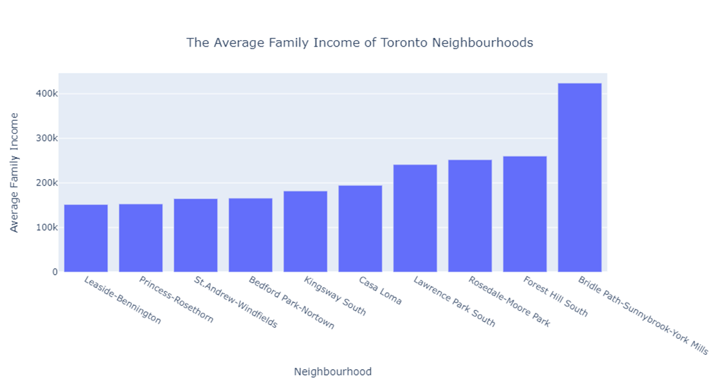

Slide 9
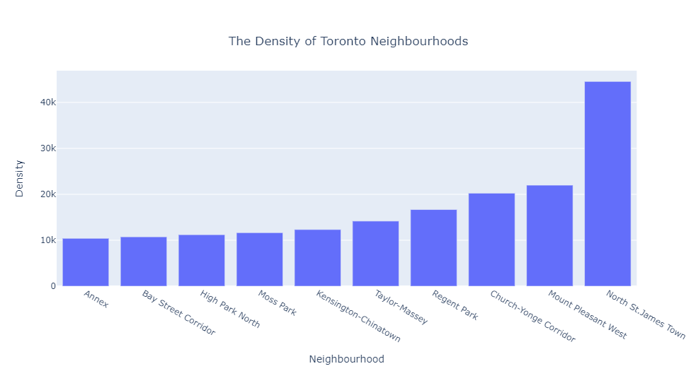
To the right, we can find the densities of various neighborhoods.
The data has been sorted to present the top 10 neighborhoods of highest density.
The neighborhood with the highest density is North St. James Town.

Slide 10
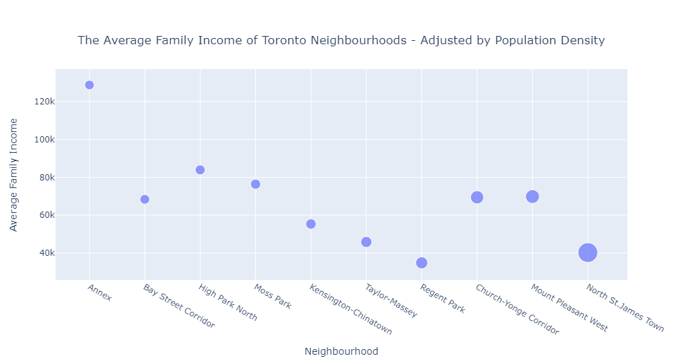
In our final presentation, we display a scatter plot of the neighborhoods by factoring the average family income and population densities.
We will focus on the three rightmost regions – North St. James, Mount Pleasant West and Church-Yonge Corridor.

Slide 11
Conclusion
Our top three candidates are North St. James, Mount Pleasant West and Church-Yonge Corridor.
By observing the data, the neighborhood with the highest density is North St. James. However, it has a below average family income – at 40 230$.
The 2nd and 3rd neighborhoods are Mount Pleasant West and Church-Yonge Corridor. These, in contrast, have an above average family income at 69 830$ and 69 435$. The median family income is 66727$.
We recommend Mount Pleasant West and Church-Yonge Corridor as our top two candidates for the placement of Ronald’s Express. However, due diligence is required to observe correct placement of business within the region. This is best done in person and with the help of a commercial real estate agent.

Slide 12
References
1. Toronto, C., Government, C. and Data, R., 2021. Data, Research & Maps. [online] City of Toronto. Available at: <https://www.toronto.ca/city-government/data-research-maps/> [Accessed 13 July 2021].

